Slide 1
Robot Mapping with Proprioceptive Spatial Awareness in Confined and Sensor-Challenged Environments
Jacob Everist

Slide 2
Problem
Environments that are sensor-challenged and confined are difficult to robotically explore and map
Pipes
Caves
External sensors such as cameras, sonar, and LIDAR may be become inoperable due to damage, occlusions, lighting and fluid conditions

Slide 3
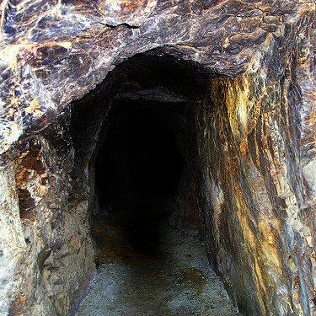
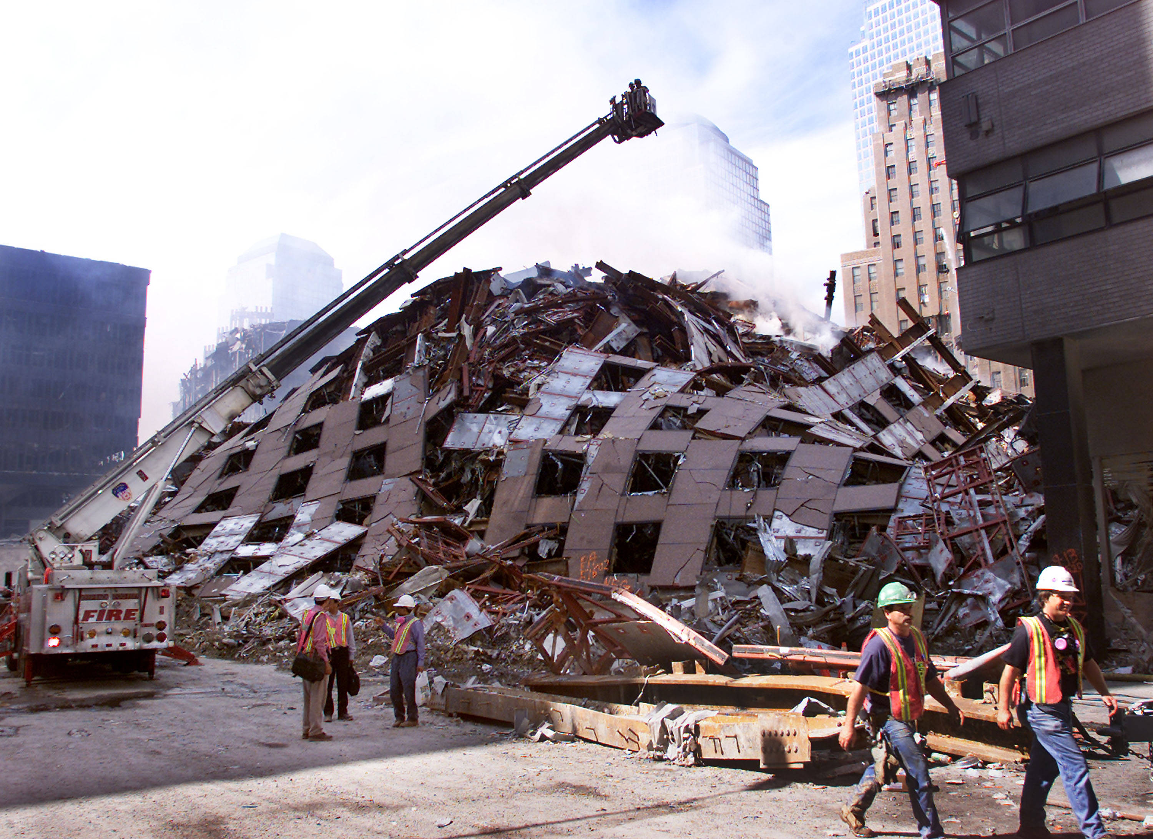
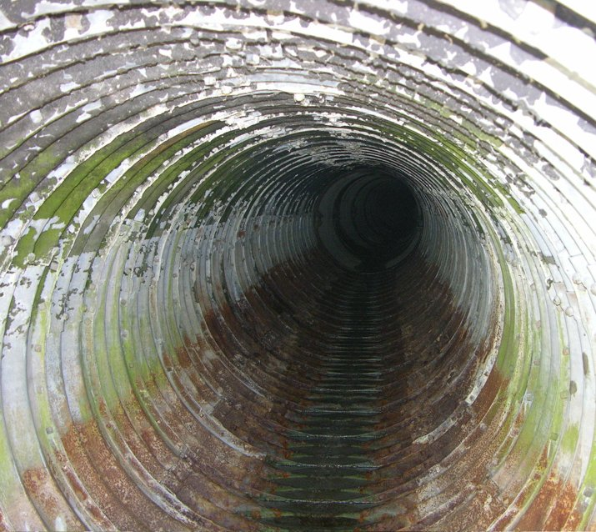
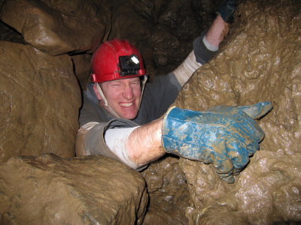
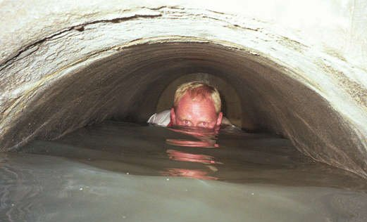
Environments

Slide 4
Motivation
Allow mapping and exploration of previously inaccessible environments
Flooded mines and caves
Pipes and sewers
Debris piles
Seek solution invariant to ambient fluids (air, transparent liquid, opaque liquid)
Impacts
Cave exploration
Geology
Search and rescue
Pipe inspection

Slide 5
Mining Disasters
West Virginia, 29 dead, 2010
Utah, 9 dead, 2007
West Virginia, 12 dead, 2006
Kentucky, 5 dead, 2006
Alabama, 13 dead, 2001

Slide 6
Earthquakes
Haiti, 222570 dead, 2010
Sumatra, 1117 dead, 2009
Sichuan, 87587 dead, 2008
Peru, 514 dead, 2007
Java, 5749 dead, 2006
Pakistan, 80361 dead, 2005
Sumatra, 227898 dead, 2004
Iran, 31000 dead, 2003

Slide 7
Cave Exploration

Slide 8
Utility Inspection

Slide 9
Rediscover Old Infrastructure

Slide 10
Related Work
Mapping underground mines [Thrun04]
Pipe inspection [Fukuda89]
Flooded subterranean caves [Gary08]
Robot sub under sea ice [Kunz et al 08]
Geometric contact detection [Kaneko94], [Grupen,Huber 93], [Haidacher02], [Mimura94]
Probing the boundary in an oil well [Mazzini11]
Initial work sensing void space [Everist09]

Slide 11
Related Work (overview)
SLAM
Underground Mapping
Pipe Inspection
Tactile Sensing
Geometric Probing
Contact Detection
Snake Robots
Pigging

Slide 12
Related Work (1)
SLAM
(Cheeseman 1986)
(Durrant-Whyte 1991)
Underground Mapping
Mines (Thrun 2003)
Sink holes (Gary 2008)
Ice lakes (Stone Aerospace 2010)
Pipe Inspection
Wheels, treads, walkers, snakes
(Fukuda 1989)
(Kawaguchi 1995)
(Suzumori 1999)
(Wakimoto 2003)

Slide 13
Related Work (2)
Tactile Sensing
Whiskers (Russell 1992)
Bump sensors
Tactile surfaces (Liu 2003)
Shape classification (Erdmann 2001)
Geometric Probing
Polygon reconstruction (Skiena 1988)
Contact Detection
2D (Grupen 1994)
3D (Kaneko 1995)

Slide 14
Related Work (3)
Snake Robots
Biomechanics (Hirose 1974)
Control (Chirikjian 1995)
Design (Choset 2007)
Pigging
“Pipeline Pigging Technology” (Tiratsoo 1992)

Slide 15
Existing Approach

Slide 16
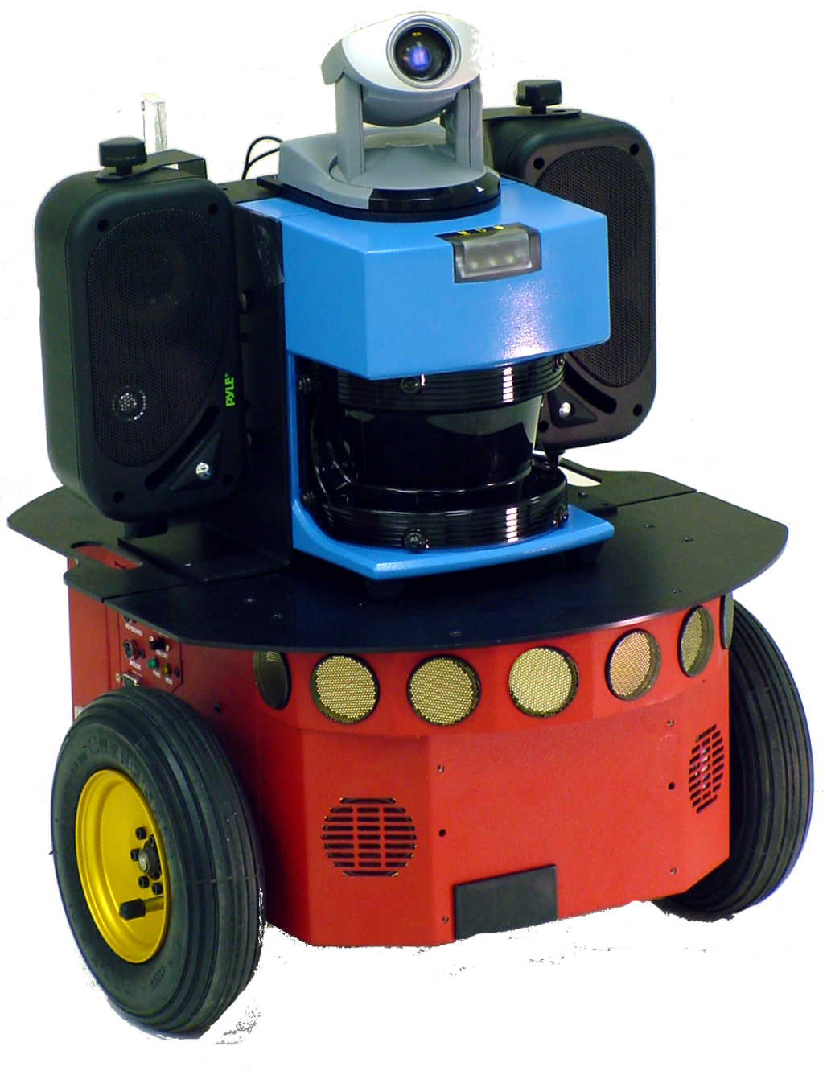

Slide 17
Wheels

Slide 18
Sonar
Wheels

Slide 19
LADAR
Sonar
Wheels

Slide 20
Vision
LADAR
Sonar
Wheels

Slide 21


Slide 22
Incompatible Mobility

Slide 23
No Odometry

Slide 24
Failure by Proximity

Slide 25
Failure by Ambient Fluid

Slide 26
Major Challenges
Sensing
Variant fluids
Reflections, distortions
Dark
Movement
Unstructured environment
Debris, caves
Wall widths
Motion Estimation
No odometry or dead-reckoning
No GPS

Slide 27
Approach
Algorithmic methods for robotically mapping
confined environments
proprioceptive sensors only
Use an articulated mobile robot
Use joint sensors and geometry to reconstruct robot posture
The robot should have many joints, known geometry, and a far reach
Use robot posture to identify void space
Sweep the body to build up information
Boundaries are indirectly inferred from mapped void space

Slide 28
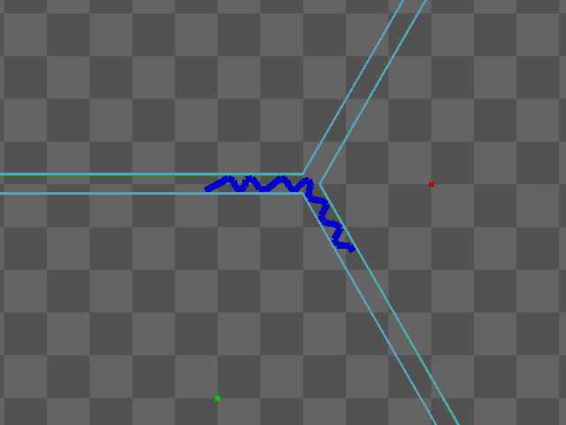

Slide 29
Assumptions
Robot
All external sensors have failed
Only joint angle sensors are available
Set max torque or current
Body geometry is known
Environment
Confined
Pipe-like or tubular
Rigid walls
Flat ground, no slopes

Slide 30


Slide 31
Evaluation
Success metric:
Can the robot generate a map of the environment?
Can the map be used by robots for navigation?
Task:
Use the robot the explore and generate the map
Give the map to a new robot, direct it to a location on the map
Does it reach the target location?

Slide 32
Contributions
Sensing the environment through joint sensors, no contact, vision, or range sensors. First method without exteroception (IROS2009)
Map the environment with no fixed reference frame. Mobile platform
New map representation for confined, tubular, void spaces
Operates without landmark features
Uses holistic shape of the environment
Localization by ICP over medial axes of shapes
Mapping with only highly local information
no sensing at a distances
Detection of junctions that are only partially observable in non-looped environment
Probabilistic representation over space of possible maps
Can map Y junctions, T junctions, X junctions, L and 45deg junctions in non-looping environments
Proprioceptive odometer/dead-reckoning (self-posture motion model)

Slide 33
Outline
Sensing Void Space
Position and Orientation
Control and Locomotion
Motion Estimation
Environmental Landmarks and Features
From Poses to Maps
Mapping with Junctions
Probabilistic Mapping

Slide 35
Sensing with Proprioception
Obstacle detection is standard approach for mapping methods.
Use external sensors to detect boundaries
With proprioception only, using various contact detection strategies, we can get detail, sparse, or implicit boundary detection

Slide 36
Contact Detection
Brushing objects with compliant joints and deliberate actions
Gives detailed boundary information.
time-consuming and not well suited to long-range exploration
primarily for detailed exploration of small space
Kaneko, Haidacher, Grupen

Slide 37
Finger-Probing
Poke the wall with the head of a finger or snake
When head ceases motion, this becomes “contact”
More sparse data
prone to noise
lots of false positives

Slide 38
Void Space
Inference of the boundary from shape of void space
Tells you where obstacle are not, not where they are

Slide 39
Sensing Void Space
Problem: in the event of failure of external sensors, how do we sense the environment with proprioception?
Solution: Build maps of void space using the robot’s body to sweep out the space

Slide 40
Proprioceptive Spatial Awareness
Use movement and body geometry to build awareness of space
Plot into a local map representing void space

Slide 41
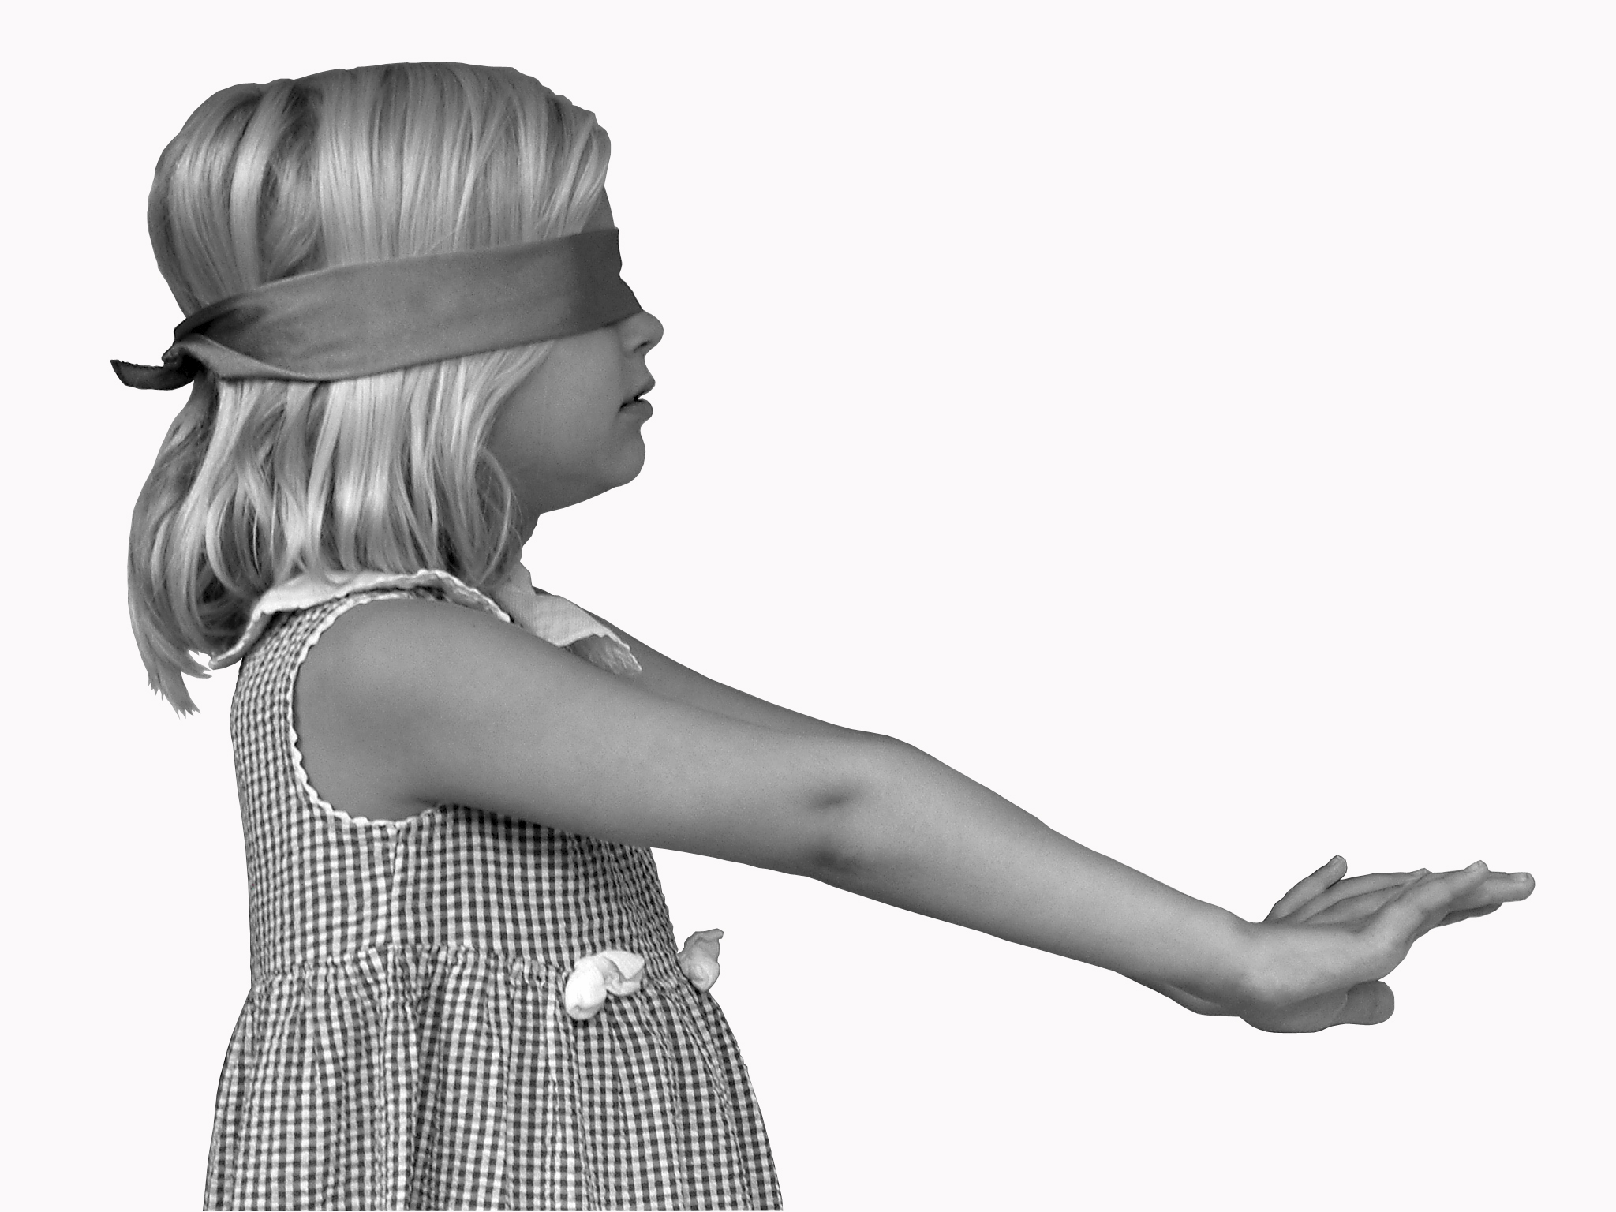
External Sensor Failure

Slide 42
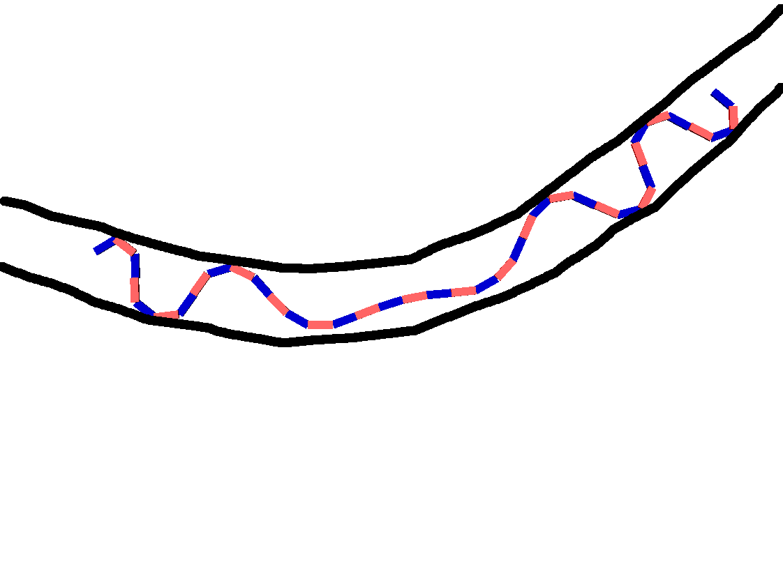

Slide 43
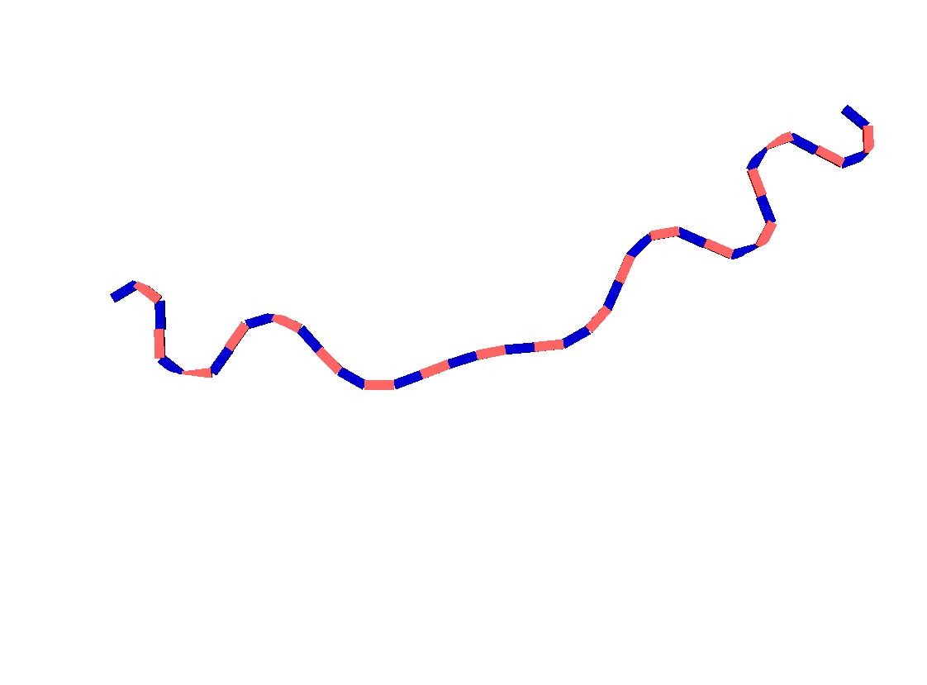

Slide 44
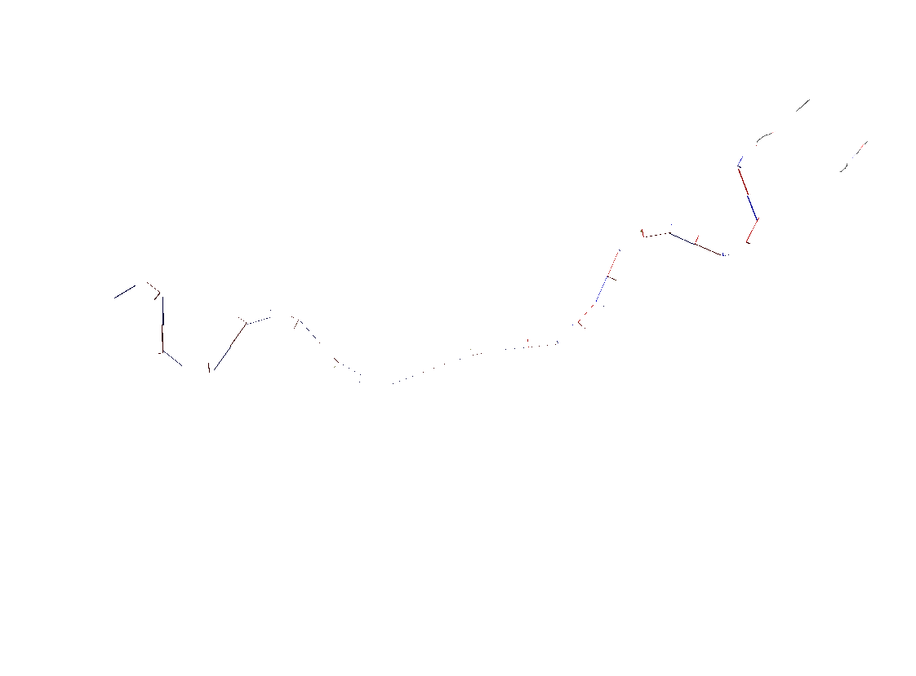

Slide 45
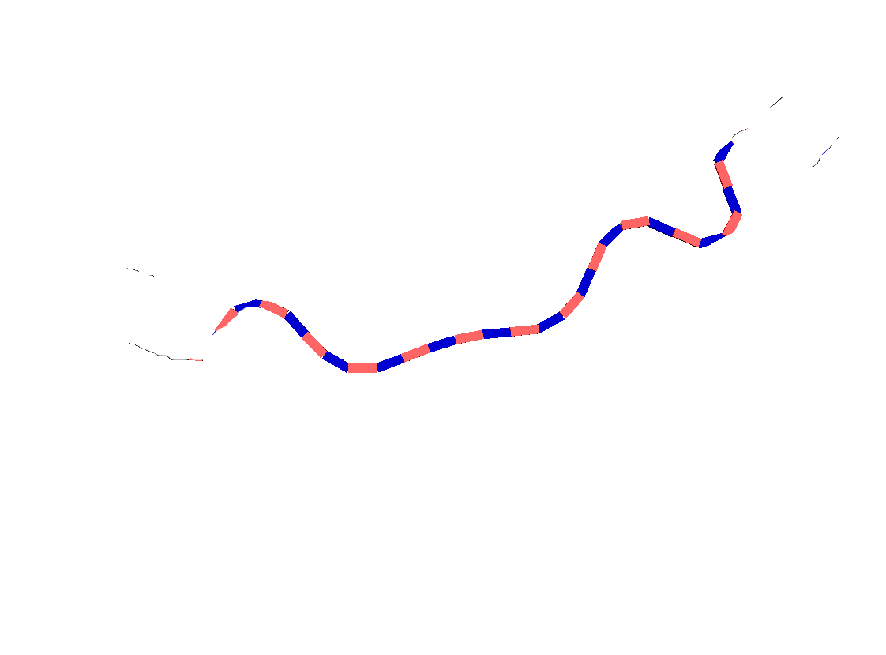

Slide 46
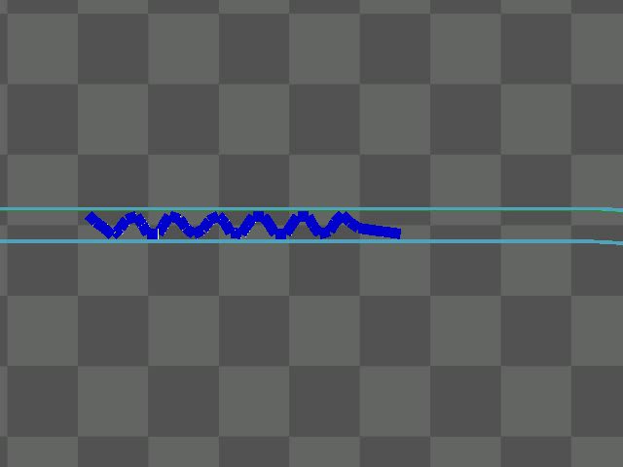
Probing the Environment

Slide 47
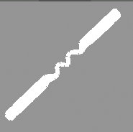
Free Space Map

Slide 48

Sensing Requires Reference
Anchoring provides global frame
Bad references cause “bowtie effect”

Slide 49
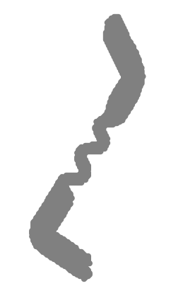
Free Space

Slide 50
Free Space
gap in free space

Slide 51
Free Space
gap in free space
smooth out these gaps

Slide 52
Free Space Smoothing
Alpha shape (Edelsbrunner 1983)
Generalization of convex hull

Slide 53
Free Space Smoothing
Alpha shape (Edelsbrunner 1983)
Generalization of convex hull
Input:
Set of points
Circle radius r

Slide 54
Free Space Smoothing
Alpha shape (Edelsbrunner 1983)
Generalization of convex hull
Input:
Set of points
Circle radius r
If some circle C has points p and q on boundary and C contains no other points

Slide 55
Free Space Smoothing
Alpha shape (Edelsbrunner 1983)
Generalization of convex hull
Input:
Set of points
Circle radius r
If some circle C has points p and q on boundary and C contains no other points
Add edge between p and q

Slide 56
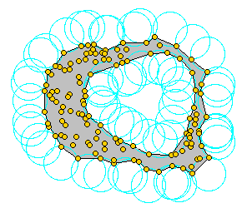
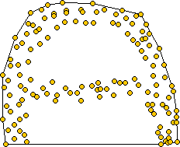
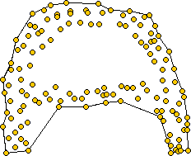
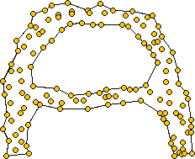
Examples

Slide 57
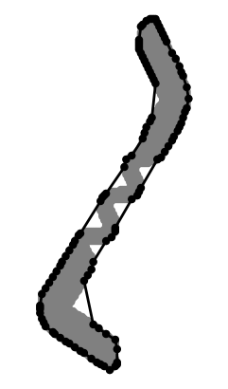
Free Space Smoothing

Slide 58
Free Space Smoothing
gap smoothed over

Slide 59
Free Space Smoothing
gap smoothed over
sharp features lost

Slide 60
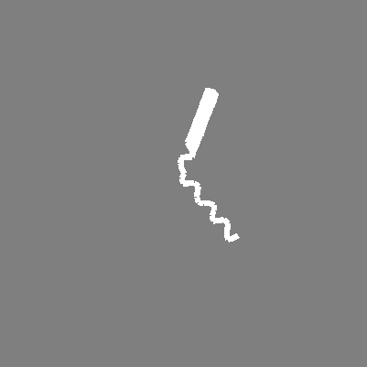

Proprioceptive Sensing
The posture image I_{t} , is captured at pose X_{t} by sweeping the body in one direction and anchoring in the other direction.

Slide 61
Defining Position and Orientation
Articulated robot has no high-inertia center of mass to serve as its coordinate frame.
Individual segments are rotating and undulating
Need method to determine direction of snake robot.
Information not provided by individual body segments

Slide 62
Approach
Robot-centered Coordinate Frame
dynamically generated from B-spline
Backbone Curve defined by Chirikjian (example)
“Posture Curve” generated by smoothed B-spline with segment frame origins as input points (example)
Generates the Posture Frame for local coordinate system

Slide 63
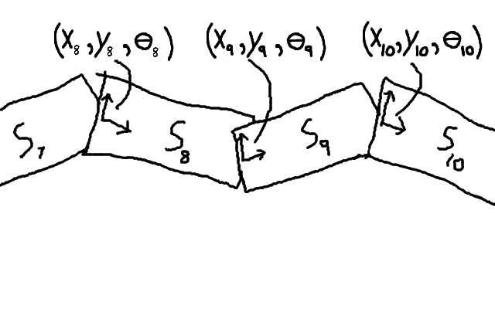

Slide 64
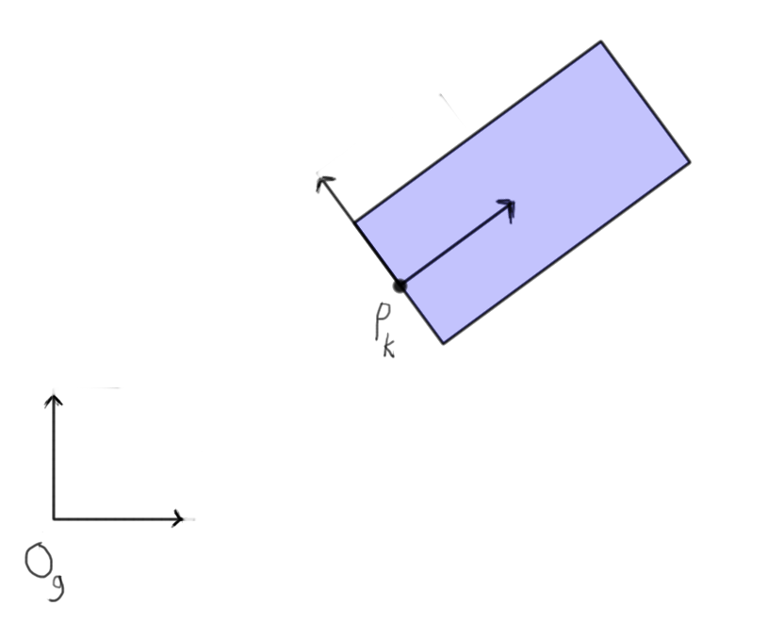

Slide 65
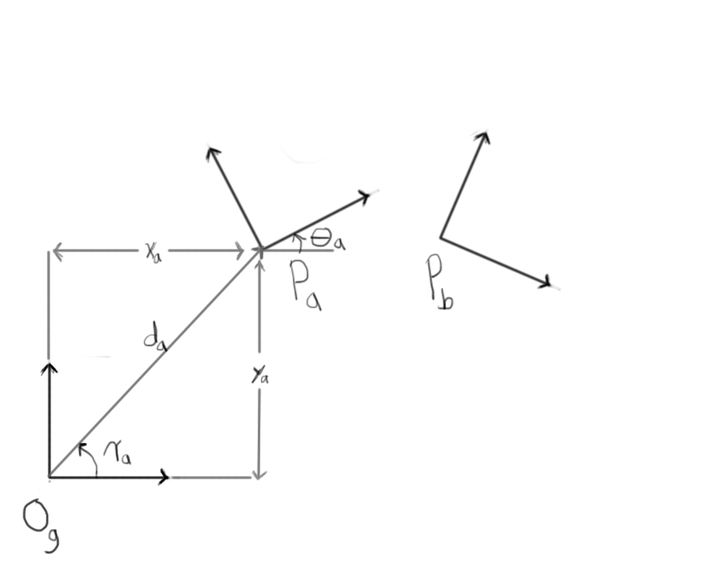

Slide 66
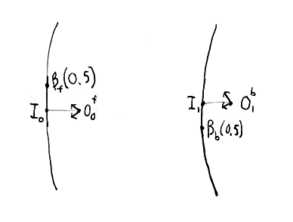

Slide 67
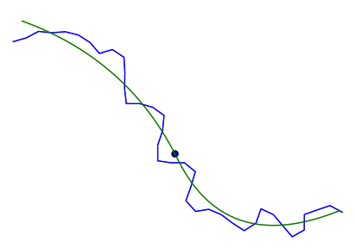

Slide 68
Control and Locomotion
Not major contribution because not implemented on physical robot.
Concertina locomotion
Snake control, backbone curves (chirikjian)
Segmented behaviors
Adaptive anchoring
Smooth motion and compliance
Stability detection

Slide 69
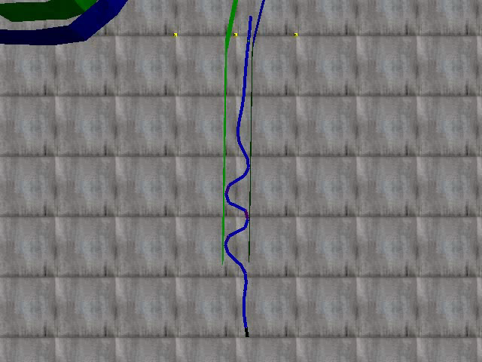
Snake Locomotion

Slide 70
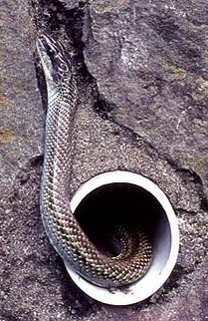
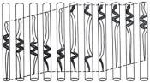
Concertina Motion
Gans 1980

Slide 71
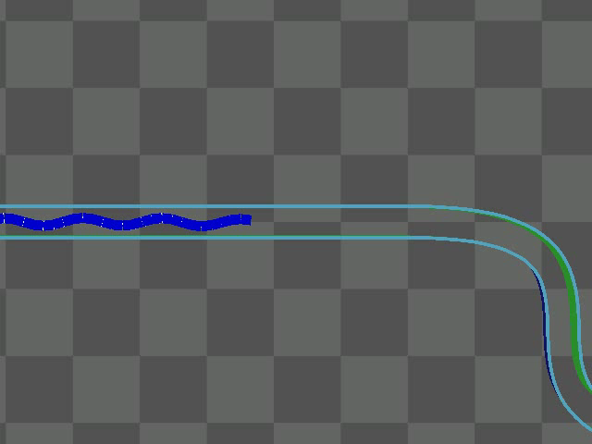
Adaptive Concertina Gait
Variable width pipes
No tactile sensors

Slide 72
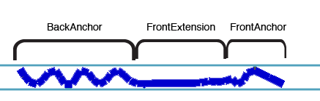
Segmented Behavioral Control

Slide 73
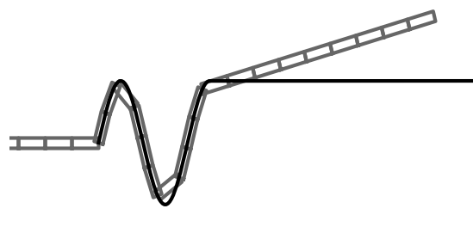
Snake Control
Sine curves with configurable amplitudes per period
Backbone curve fitting (Chirikjian 1995)
Adaptive anchoring

Slide 74
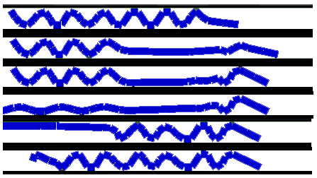
Gait Stages
Rest-State
Front-Extend
Front-Anchor
Back-Extend
Back-Anchor
Rest-State

Slide 75
New Ideas
Adaptive snake robot locomotion with a version of concertina gait
Detect anchoring with joint sensors

Slide 76
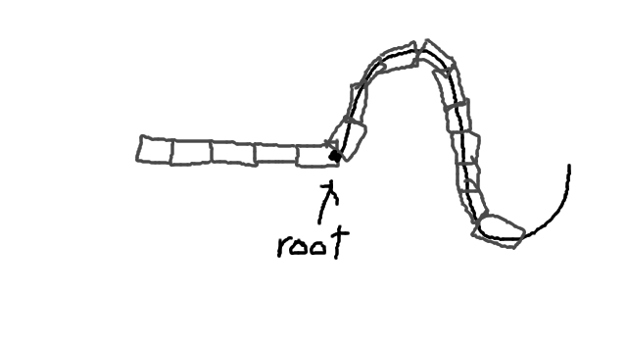

Slide 77
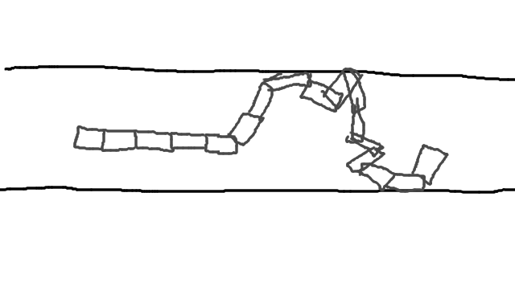

Slide 78
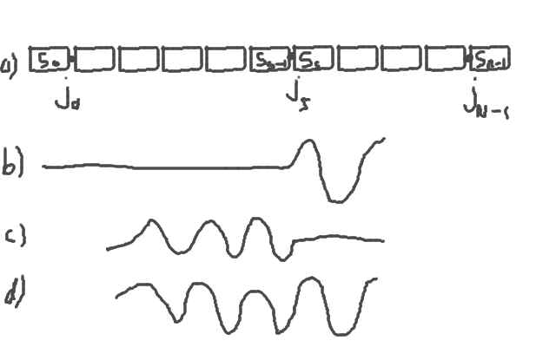

Slide 79
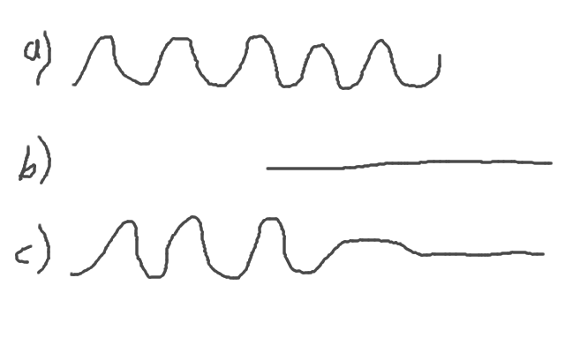

Slide 80
Environmental Landmarks and Features
In order localize the robot and build a map, we need some features of the environment to exploit
Candidates include:
Obstacles/walls
Corners
Shape features
Spatial features
bloom, arch, bend

Slide 81
Corner Detection
Hypothesis: find corner features in void space image and use them as mapping features
Corner in void space image implies a junction
Assumes junctions have sharp corners. Smoothed corners need not apply.
High false positive rate
Serendipitous detection of actual corners
Frequent misses or reject by algorithm
Better suited to sensors that measure complete boundary, not incomplete boundary

Slide 82
Shape Features
Given a blob of void space, what properties can we extract?
Shape of the robot’s posture in space should give us information about the environment.
How can we extract this information and represent it in an useful way?

Slide 83
Shape Features
3 options
Anchor Curves:
Anchor points, create smoothed boundary
Wall Curves:
Alpha shape, polygon boundaries
Spatial Curve:
Medial axis or “skeletonization” (cite)
3 example images

Slide 84
Spatial Curve
Smoothed version gives us a curve representation of the space
Union of multiple void space images with medial axis give us graph representation of environment topology

Slide 85
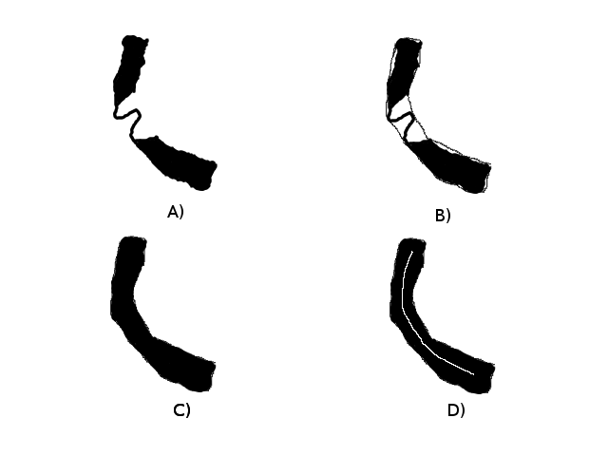

Slide 86
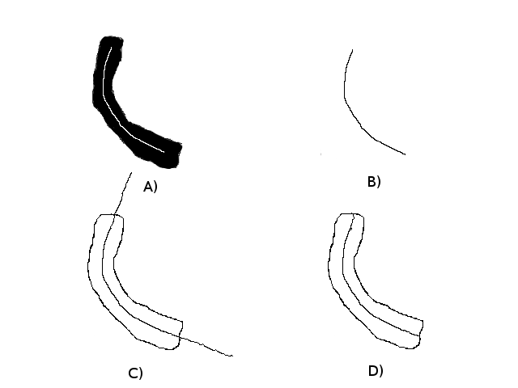

Slide 87
Spatial Features
Bloom
Arch
Bend

Slide 88
Motion Estimation
Self-Posture motion model
slow time
high accuracy
Naive motion model
fast time
low accuracy
Step model with inter-pose overlap invariance
fast time
medium accuracy
Shoot step
fast time
medium accuracy

Slide 89
Self-Posture Motion Model
How do we estimate the change in pose as a result of a locomotion step?
Anchoring approach
kinematically track fixed points in the environment during locomotion
requires that reference points are sufficiently stable
does not slip, wobble, etc. (anchor failure modes)
high accuracy but costly in time, slow-moving
in event of slip, high rotational error
high cost, high reward, catastrophic error possible
not good enough (multi-day simulations)

Slide 90
Naive Inter-Pose Step
Pose A and pose B between locomotion step
Displace a fixed distance along spatial curve
(graphic here)
Possible bus has high error since the two poses don’t always overlap
Fast to compute though

Slide 91
Overlap Inter-Pose Step
Extend the naive step
Recognize that consecutive poses overlap each other
assume invariant condition
Perform the naive step displacement
Perform Iterative Closest Point (ICP) between two curves to find best fit
ICP details:
Generalized ICP (cite)
covariance matrices with Mahalanobis distance cost
extra details that keep partial overlap
point-to-line constraint
problem space reduce from (x,y,\theta) to (u,\phi)
Results

Slide 92
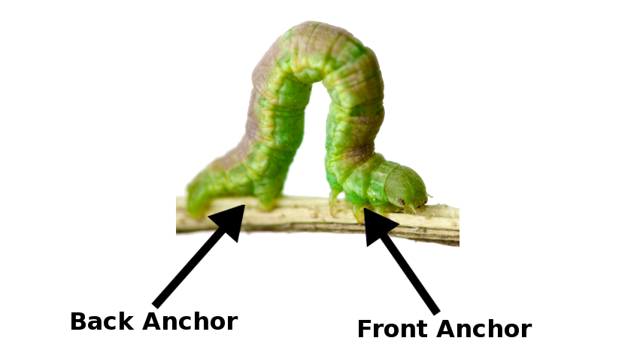
Inchworm Approach

Slide 93
Self-Reference Motion Model

Slide 94
Concertina Analogue

Slide 95
Concertina Analogue

Slide 96
Reference Points
Each segment a potential reference point

Slide 97
Reference Points
Each segment a potential reference point
Old reference points used to compute new

Slide 98
Reference Points
Each segment a potential reference point
Old reference points used to compute new
A segment becomes a reference if:
Segment is part of an anchor
Local joints are “stable”

Slide 99
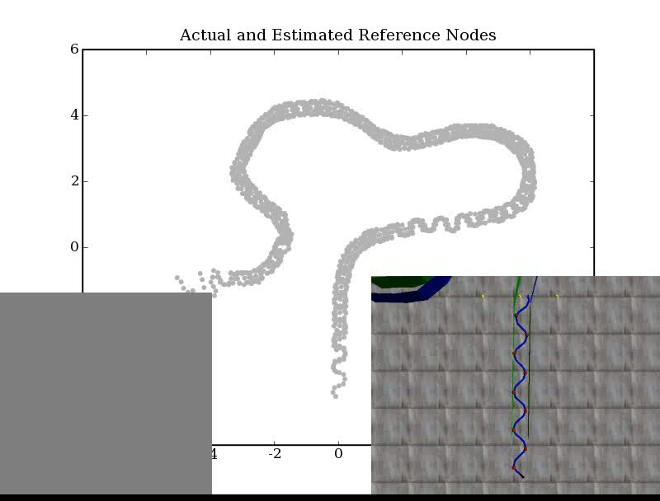

Slide 100
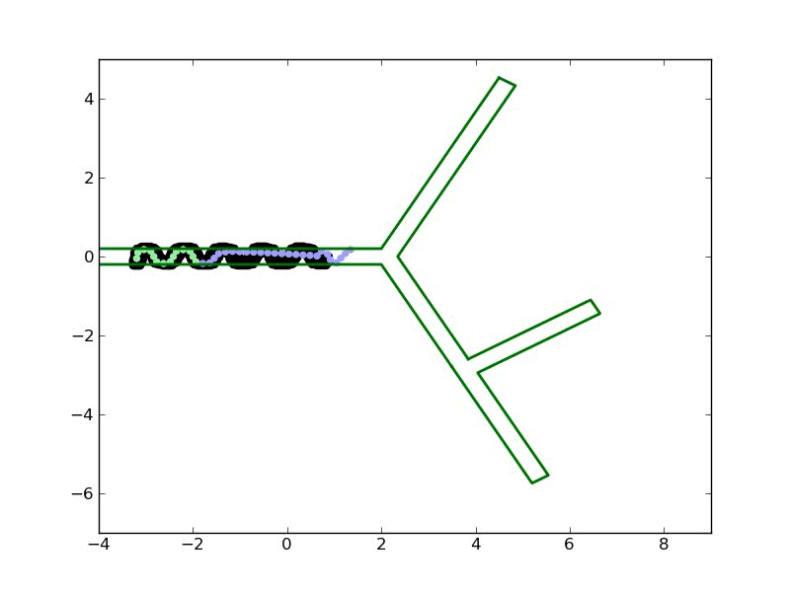
Motion Estimation Error

Slide 101
Motion Estimation Error
Caused by reference points in motion

Slide 102
Motion Estimation Error
Caused by reference points in motion
Good anchoring is key to good motion estimation

Slide 103
Brief detour on anchoring

Slide 104
Anchor Failure Modes
Floating references (solved)
Locally stable but not anchored
Weak contact (minimized impact)
Not strong anchor
Buckling (solved)
Joint gives out under high torque
Impulse force (minimized impact)
Sudden injection of force causes wobbling before restoring to original position
Whole body slip (open)
Undetectable movement of whole body… no joints move
Need accelerometer
Meta-stable anchoring (open)
Strong in one direction but comes lose in other (funnel anchor)

Slide 105
Anchoring
Anchoring process

Slide 106
Anchoring
Anchoring process
Search for amplitude

Slide 107
Anchoring
Anchoring process
Search for amplitude
Joint resistance indicates contact

Slide 108
Anchoring
Anchoring process
Search for amplitude
Joint resistance indicates contact
Find snug fit but not overly stressed

Slide 109
Anchoring
Anchoring process
Search for amplitude
Joint resistance indicates contact
Find snug fit but not overly stressed
Perform jerk test to see if secure

Slide 110
Anchoring
Anchoring process
Search for amplitude
Joint resistance indicates contact
Find snug fit but not overly stressed
Perform jerk test to see if secure
If not secure, start over with more segments

Slide 111
Anchoring

Slide 112
Current Anchoring Results
Works on variable width (within limits)
Works on smooth vs irregular surface
Works on 2-way, 3-way, 4-way junctions
When failure occurs, the 2nd or 3rd retry will succeed

Slide 113
Results
Naive + GPAC Frame
Self-Posture + Body Frame
Pose Step + GPAC Frame (discussed later)
Shoot Step (discussed later)

Slide 114
Mapping Problem
Actions:
Move commands:
Sensing:
Posture sequence:
Posture Images:
Map Parameters:
Poses:

Slide 115
Poses
Pose is the position and orientation of a posture image in the posture frame
Need ways to generate
Initial condition:
Set
or ground truth pose.

Slide 116
Use Overlap Inter-Pose Step
Start with X_1 given
Sense posture images
Action: ‘f’
Experience: I_1, I_2, f, I_3, I4
Solve for X_2, X_3, X_4
X_2 = overlap(X_1, I_1, I_2, d=0)
X_3 = overlap(X_1, I_1, I_3, d=+k)
X_4 = overlap(X_3, I_3, I_4, d=0)

Slide 117
Results
Simple map example (graphic)
Problem:
only uses last to constrain next
does not use all history
breaks when backtracking
show example of breaking (graphic)

Slide 118
Pose Graph
Try using GraphSLAM technique with poses
Use overlap step to create constraints between poses
Problem:
depends on common feature landmarks viewable from different poses to create feature constraints
We have NO features that act as point landmarks
Our overlap constraints do not follow normal distribution
Do not fit in standard GraphSLAM formulation
How do we connect/constrain new poses to old poses without landmarks?

Slide 119
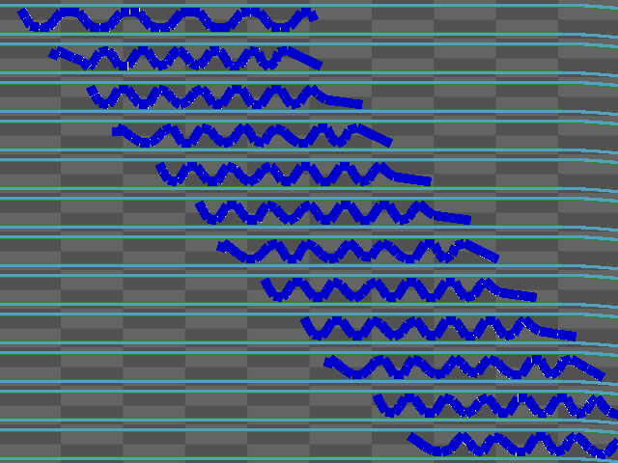
Stable Poses

Slide 120
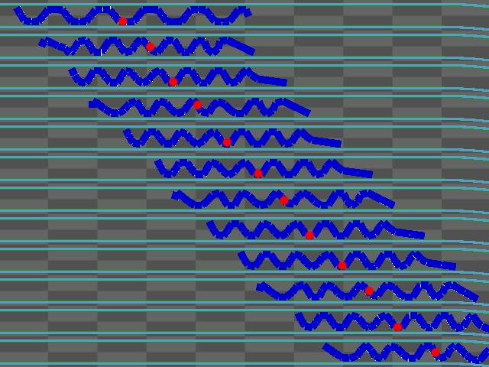
Root References

Slide 121
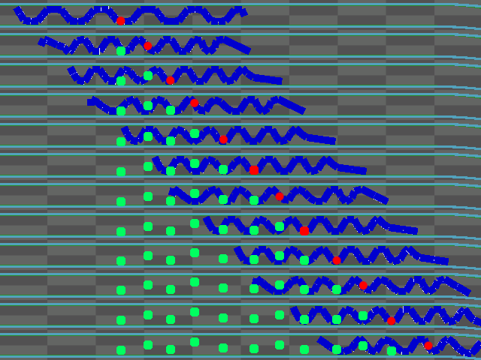
Pose Nodes

Slide 122
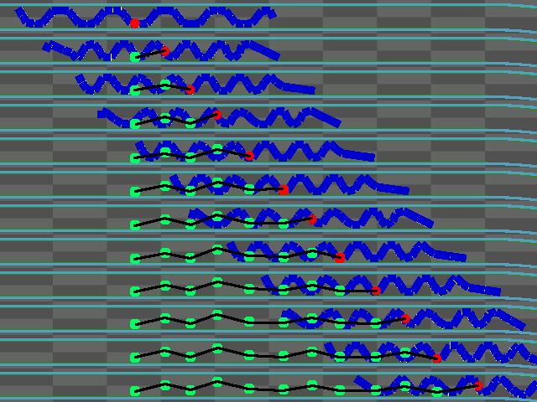
Pose Graph

Slide 123
Aggregate Pose Constraint
To make use of complete history of poses, we take the union of all the spatial images I_1:t situated in space at X_1:t
Compute medial axis of the union and gives us a curve that describes the shape of the environment
We define this curve to be called a “shoot”
Now we can perform localization of a new pose on the existing map
We can create constraints without mutually observable point features

Slide 124
Aggregate Pose Constraint
Motion estimation by overlap inter-pose step
Given the estimated pose, perform ICP between new pose’s spatial curve and map’s shoot curve

Slide 125
Aggregate Pose Constraint
Now we can perform backtracking
Featureless lengths of pipe vary in length accuracy
Bends and angles are well-formed
Results chart with single-path examples and backtracking (chart)

Slide 126
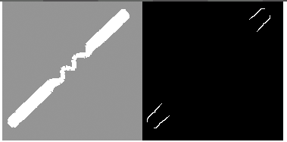
Node in the Graph
Estimated Pose
(X, Y, A)
Local Map

Slide 127
Global Map
Render pose graph
Plot local maps to estimated poses

Slide 128
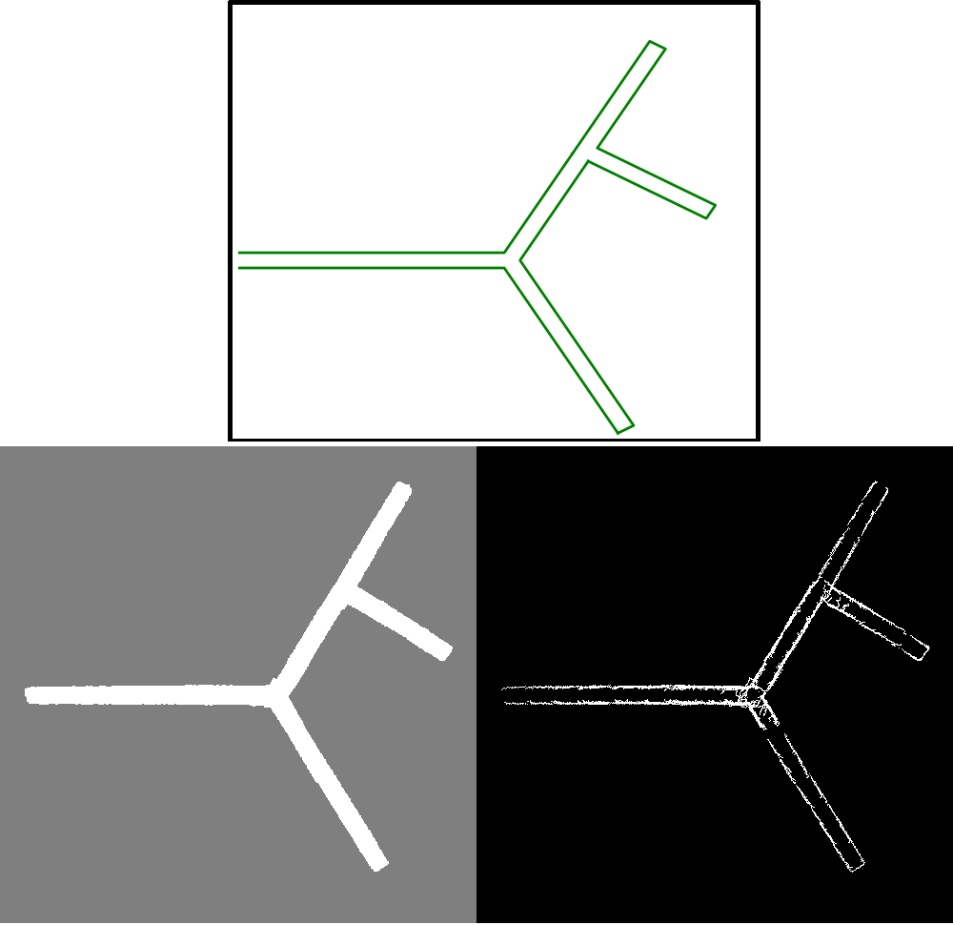

Slide 129
Mapping with Junctions
A shoot curve breaks down when we have a junction since there are many possible configurations for the pose to localize to
Overlap is undefined for a spatial curve that is not contained or extending the shoot
A spatial curve that does not have these properties is diverging
Overlap ICP leads to local minima
Define:
Contained: spatial curve is contained by shoot curve
Extension: spatial curve extends from the terminal
Divergence: spatial curve bends away from shoot curve
(graphics)
Alternately, we could localize the spatial curve onto the full skeleton from the union of spatial images in a junctioned environment
However the ICP on the skeleton leads to many local minima depending on the initial condition
Such junctioned environments include 3-arm or 4-arm junctions such Y, T, and cross junctions
Junctions are not directly observable from spatial images.

Slide 130
Mapping with Junctions
In the event of a divergence, the map representation must be extended
A new shoot is created that diverges from the original shoot whose origin is the point of divergence. The branch point
Thus the term “shoot” is like the branches of a plant.

Slide 131
Mapping with Junctions
In the event of a pose that straddles both shoots, we localize to a curve that is a splice of the two shoots
Define shoot as
a set of poses
an originating shoot ID
a shoot frame origin
transform from parent frame to child frame
Shoot curve is dynamically generated from
the union of the set spatial images
compute the medial axis skeleton
trim at the branch point
find the longest path

Slide 132
Mapping with Junctions
Rules:
All shoots have parent-child relationships
If pose overlaps multiple shoots, membership is to the junior shoot
can have multiple membership between siblings
Shoot curve and branch points dynamically generated from
set of spatial images
shoot membership
estimated poses

Slide 133
Mapping Process
Mapping process has 5 major stages
Locomotion step
Proprioceptive sensing
Motion estimation
Add to shoots
Localize
Locomotion and sensing still remain the same

Slide 134
Mapping Process
Motion estimation is augmented to include all splices of shoots for displacement.
Overlap step followed by ICP on each splice.
Select the result that has lowest cost
Evaluation function = (equation)

Slide 135
Mapping Process
Add-to-shoots classifies a new pose to an existing shoot or determines if a new shoot needs to be created
If new spatial curve is diverging after motion estimation, then we branch and create a new shoot.
Otherwise, we proceed to next mapping step.

Slide 136
Mapping Process
We localize on the existing shoots.
For all spliced combinations of shoots, ICP to spliced curve the pose’s spatial curve
Select best fit via evaluation function
Evaluation Function = (equation)

Slide 137
Results
Results show the successful detection and mapping of junctions with some error
Particularly where the different arms of the junction intersect.
The angles of the junction are correct, but the arms don’t necessarily align.
Similarly, on the return to a branch arm, we cannot necessarily know if we have been to this arm before or if we need to create a new one.
It is possible to create multiple versions of the same branch.

Slide 138
Challenges
The challenges are:
aligning junctions (graphic)
associating with the same junction, not duplicating branches
false branches

Slide 139
Branch Detection
Some evaluation is required to determine whether a new shoot needs to be made
The efficacy of the detector determines whether or not we have false positives or false negatives
Our evaluation function = K(x) (equation)
The function requires tuning and there are numerous cases where the branch evaluation will fail, regardless of tuning.

Slide 140
Mapping with Junctions
branch condition
extension vs. divergence
divergence properties (discontinuity)
curve operations

Slide 141
Mapping Problem
Actions:
Move commands:
Sensing:
Posture sequence:
Posture Images:
Map Parameters:
Poses:
Shoots:
Branch Points:

Slide 142
Probabilistic Mapping
Pose particle filter
Branch point space
Branching decision (yes/no)
Evaluation function of Poses, Branch points, Branch Decisions

Slide 143
Probabilistic Mapping
Given that there are a number of different parameters and decisions to build the map, it is easy to build the map incorrectly
If we consider a space of possible maps, we can find the most likely map based on the robot experience
Given our definitions, find P(x|a,s) and the most likely map

Slide 144
Probabilistic Mapping
We show how each component of the map is represented probabilistically
pose
motion estimation
localization
shoot branch location
multi-branch evaluation
branch decision
hard problems, cross and T junctions
spatial features
multi-junction environments

Slide 145
Poses
Pose, represented by P(X)
where x = (x,y,\theta)
We represent a sampling of possible poses as points on the shoot map
Each sample is individually displaced and localized

Slide 146
Motion Estimation
Each locomotion step on each pose particle is displaced a distance with some probability
A displacement is randomly sampled from a normal distribution with mean \mu and variance \sigma
There is 10% chance that the displacement is backwards

Slide 147
Localization
After each sample has been localized, they are evaluated for fitness and resampled
Using the localization evaluation function
(equation)

Slide 148
Shoot Branch Location
When branching a new shoot, we cannot guarantee it is placed in the correct location.
Particularly when we are trying to correctly align the arms of a junction
If we represent the space of possible branches, then we can select the most likely after sufficient evidence has been gathered
Particularly we are interested in the joint probability distribution of P(X,B) = P(B|X)P(X)
where P(X) can be computed by the evaluation function on each of the pose samples
P(B|X) is the likelihood of a branch position given the current pose X
Branch positions are discretized and only the ones in the immediate vicinity of pose x are considered
For each sample pose, we evaluate 5 possible branch locations.
The configuration of the child shoot w.r.t. its parent is modified by placing its frame origin on different locations on the parent shoot curve.
Evaluation is based on the overlap consistency of the shoot skeletons and the pose’s spatial curve

Slide 149
Multi-Branch Evaluation
In the event of proximity to multiple branch points, we must consider the joint distributions of P(X|B1,B2)P(B1,B2)
Given K states for each branch, there are K^2 combinations for a pair of branches
The number of combinations increases exponentially for every additional branch
The order of calculations is O(N*max(B*K,1)*(2+B choose 2))
N = # of pose samples
B = # branches
K = # branch samples
So their complexity grows rapidly with
the number of pose samples we have
the number of branches under consideration
the resolution of our branch point discretization

Slide 150
Branch Decision
Given that our branch detection algorithm is prone to errors and that we need to resolve whether the robot has entered an existing branch or a new branch, we would also like to evaluate the space of possible branch decisions.
Given for every pose, we can decide to branch/no-branch, there are 2^t possible combinations for n poses.
We also have N pose samples that may give different results from the branch detector.
To reduce the space, we only consider the maximum likelihood sample for branch detection.
If the branch detector evaluates True, we create two maps:
map hypothesis with the new branching shoot
map hypothesis without the branch

Slide 151
Branch Decision
Each separate map hypothesis is evaluated independently with its own pose and branch distributions.
In the event that a new robot pose is unable to localize to the map or the map becomes inconsistent, the map hypothesis is eliminated.
A map hypothesis becomes inconsistent when a child shoot no longer diverges from its parent.

Slide 152
Hard Problems
Cross and T junctions
Our approach works well for Y junctions and in some cases the T junction.
However, it does not work so well for cross junctions.
In order to fully align all the branch arms of a cross junction, we need 6 complete junction postures to completely describe the junction. (graphic)
Without these postures, we can describe a junction that is incorrect but is consistent with the sensed experience
Furthermore, posture 5 and 6 do not give us different experiences from just being in a straight featureless pipe.
It is currently impossible to sense whether the robot is within a junction if it is not angled in some way
Similarly, a T-junction from the side cannot detect the junction if it goes straight through.

Slide 153
Spatial Features
Up until this point, we have been able to build maps without landmark features or being able to directly sense a junction.
However, in order to solve the problem of observing junctions with straight postures, we must exploit some features of the spatial images
Upon inspection of spatial images within junctions, we notice swelling of the space where the walls don’t exist.
This swelling often indicates the presence of a junction.
We can build a detector for this feature, but we are finally making some strong assumptions about the width of the environment. That is, the width is some constant W.

Slide 154
Spatial Features
We detect 3 different spatial feature from spatial images that are indicate of junctions:
blooms: swelling at the tip
arches: internally swelling, “arched” anchors
bends: sudden turn of spatial curve, crest is the bend point
Using these landmark features, we now include proximity with each other in the evaluation of motion estimation, branch state, and pose localization.
Using this approach, we are able to map and align the arms of a T and cross junction with ease.
The addition of the spatial features makes mapping and aligning the other junction much more rapid.

Slide 155
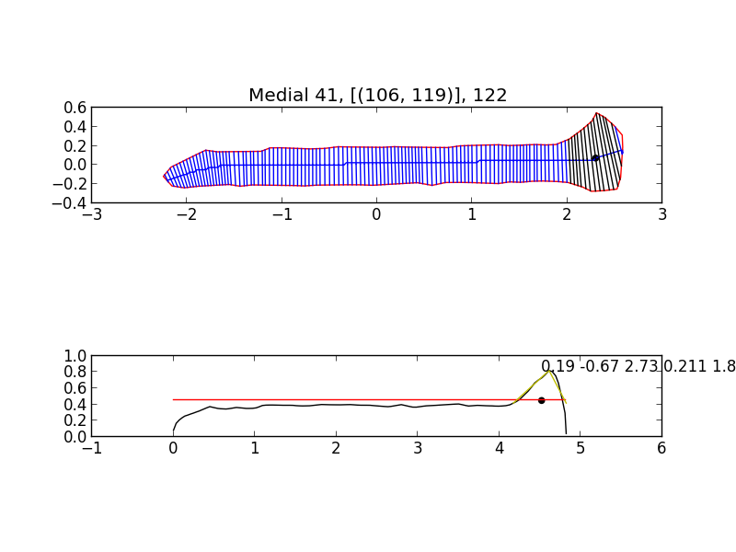

Slide 156
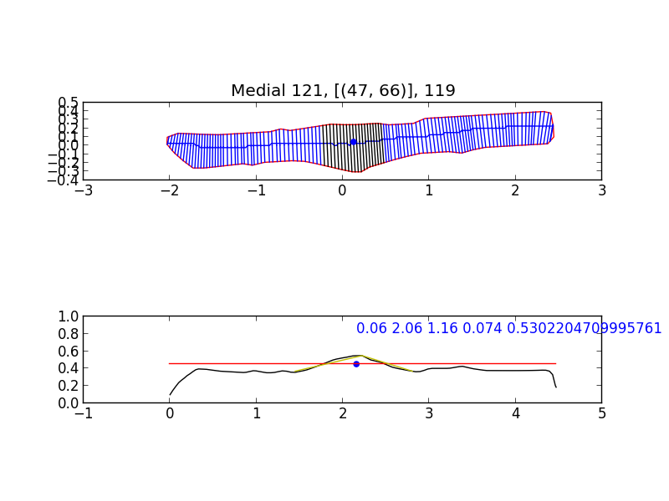

Slide 157


Slide 158
Multi-Junction Environments
We can map multi-junction environments if we assume the junction features have a minimum distance between each other
Distance is greater than twice the length of the robot posture curve.
This ensures that each junction cannot be sensed simultaneously and that features of each junction in the map cannot be mistaken for each other
This is a hard problem and we leave it for future work.

Slide 159
Navigation
Finally, in our evaluation of whether mapping is successful, we determine if the robot can use the map to navigate with
Successful navigation means our mapping algorithm is a success for that environment
Fortunately, the shoot curves and their splices provide perfect navigation paths.
They are input to our PathFollow behavior.
Localization of the robot’s pose gives us more confidence in the robot’s location
When the robot approaches the destination point, the navigation terminates.
The maximum likelihood map state is used for navigation
If in the course of navigation, a more likely map state is found, the navigation is recomputed

Slide 160


Slide 161

Particle Filter over Poses and Branch Locations

Slide 162

Pose Particles after Localization

Slide 163

Shoots
A single path of poses from an origin to a terminal point.
Shoots branch from other shoots

Slide 164


Slide 165


Slide 166
 | T Junction from Bottom | T Junction from Side | Y junction | Right L-junction | Left L-junction | Cross Junction | Straight Pipe | Irregular Pipe | Right 60-junction | Left 60-junction
Forward Locomotion
Backtracking
Single Junction
Multi-Junctions
Navigation
Legend
Success
Partial Success
Not yet demonstrated
N/A

Slide 167
Conclusion
Absence of external sensors
use proprioception to build spatial awareness (statement)
Use any robot so long as it has lots of joints and known geometry
Spatial images give incomplete information
Obstacle and extent of reach are identical
We determined that spatial curves derived from the medial axis computation give the most usable environmental data for building maps
It is possible to build robots with no sensors using proprioception and known geometry.
we developed an approach (etc), we made a promising reuslt

Slide 168
Conclusion
To estimate motion from locomotion, we developed a constrained estimate based on the confined structure of the environment and the assumption that consecutive poses will always be partially overlapping (too many words
we estimated motion from partially overlapping poses, constrained environment
In the event of a junction, we detect it if a pose’s spatial curve diverges from the shoot curve
Junctions are represented in the map by branching new child shoots
In junction environments, motion estimation and localization are accomplished by comparing their operations against all spliced curves and selecting the splice with the best evaluated utility function
The maximum likelihood map is found by modeling the state space of maps and evaluating multiple options that are most probable

Slide 169
Conclusion
N possible poses are evaluated each with K^2 possible branch configurations.
A new map hypothesis is created for each branch decision
T and cross junctions were found to be challenging with no landmark features
We found and exploited spatial features as landmarks for the presence of junctions
Multi-junction environments are capable of being mapped so long as the junctions are spaced far enough apart to prevent incorrect feature associations
We evaluate our approach as successful because we can use the generated map to navigate robot path following

